Slide 1

Project Risk Management

Slide 2
Table of content
What Is Risk Management?
Risk and Opportunity Management Overview
How Do We Manage Risk/Opportunity ?
Summary
Risk Management In Agile
Plan Risk and Opportunity Management
Identify Risks and Opportunities
Performance Qualitative Risk and Opportunity Analysis
Performance Quantitative Risk and Opportunity Analysis
Plan Risk/Opportunity Responses
Implement Risk/Opportunity Responses
Monitor Risks/Opportunities
What is Risk?
Why Risk Management?
Advantage of Risk and Opportunity Management
Tailoring Considerations

Slide 3

Course Objectives
Understand what risk management is and how important it is
Know the processes required for risk management
Understand risk management practices in Agile

Slide 4
WHAT IS RISK MANAGEMENT?

Slide 5

What is Risk?
Risk is an uncertain event or condition that if occurs, has a positive or negative effect on one or more project objectives such as scope, schedule, cost and quality.
Notes:
Pure Risk (hazard) : is a category of risk that cannot be controlled and has two outcomes: complete loss or no loss at all.
Example: Fire, theft, personal injury
Business Risk (speculative risk): Risk with potential loss or gain
Example: A new hardware costs less (or more) than you budgeted for!

Slide 6

Why Risk Management?
A PM work should not focus on dealing with problems; it should focus on preventing them
Performing risk management helps prevent many problems & helps make other problems less likely
Failure of PM to assess project risks is a major cause of project’s failure
Minimize project surprises
Anticipate problems thereby making you proactive then reactive

Slide 7



Advantage of Risk & Opportunity Management
Increase the likelihood and impact of positive events (opportunities)
Decrease the likelihood and impact of negative events (risks) in the project
To be more proactive & less reactive

Slide 8
Risk & Opportunity Management Overview
It Includes the processes of conducting the Risk Management planning, identification, analysis, response planning, & controlling risk on a projects.
Mitigate adverse impacts or capitalize on positive impacts to increase the likelihood of meeting objectives.
Plan
Identify
Analyze
Respond
Control
Notes:
Ví dụ về Risk Management
Family going on a Vacation; Hit by a risk, how they will respond in absence of risk planning or with plan in hand.
Family going on Vacation => Car without fuel => Tire Puncture
Risk Planning
Family discuss risks & plan it
Identify Risk
Car Breakdown
Lost key Accident
Change in weather (Rain)
Out of Fuel
Analyze Qualitative
Analyze Quantitative
Risk Response Plan: With Proper Risk planning & response in place, family is enjoying vacation
Car Breakdown: Prepare Garage list ➔ Call garage & get Tire Replaced. PIC: Father
Out of fuel: Prepare Gas-station list ➔ Get Fuel from nearby Gas-Station. PIC: Mother
Rain: Plan indoor activities. PIC: Son

Slide 9
Tailoring Considerations
Project Size
Does the project’s size in terms of budget, duration, scope, or team size require a more detailed approach to risk management?
Project Complexity
Is a robust risk approach demanded by high levels of innovation, new technology, commercial arrangements, interfaces, or external dependencies that increase project complexity?
Or is it small enough to justify a simplified risk process?
Is the project simple enough that a reduced risk process will suffice?
Project Importance
How strategically important is the project?
Is the level of risk increased for this project because it aims to produce breakthrough opportunities, addresses significant blocks to organizational performance, or involves major product innovation?
Development Approach
Is this a waterfall project where risk processes can be followed sequentially and iteratively, or does the project follow an agile approach where risk is addressed at the start of each iteration as well as during execution?
Notes:
Ở Fsoft, Risk Management include bên trong Project Plan:
- Đa phần đối với các dự án nhỏ (quen thuộc và không có nhiều rủi ro) thì hoạt động quản lý Risk chỉ là một mục đơn giản trong PP.
- Tuy nhiên đối với các dự án lớn, quan trọng và chiến lược, thường sẽ được conduct Risk Planning trong section Pre-Planning Meeting để detect các vấn đề có khả năng xảy ra trong dự án như: rủi ro về communication, multi-stakeholder, complex/unclear requirement …

Slide 10
HOW DO WE MANAGE RISK/OPPORTUNITY?

Slide 11
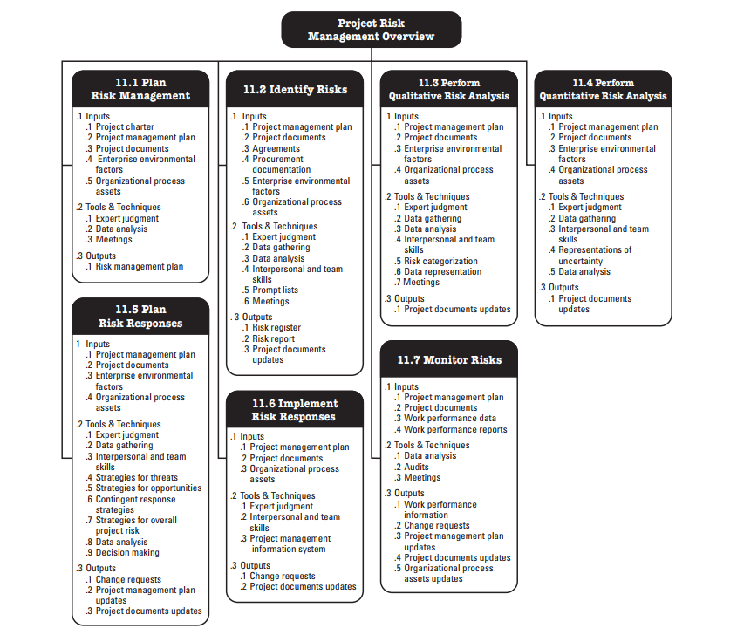
Risk and Opportunity Management Processes

Slide 12
Plan Risk and Opportunity Management
Defining how to conduct risk management activities for a project.
Ensures the degree, type and visibility of risk management commensurate with risks & importance of project.
This process is performed once or at predefined points in the project.
INPUTS
TOOLS & TECHNIQUES
OUTPUTS
.1 Project charter
.2 Project management plan
.3 Project documents
.4 Enterprise environmental factors
.5 Organizational process assets
.1 Expert judgment
.2 Data analysis
.3 Meetings
.1 Risk and Opportunity management plan
Notes:
Visibility
Match size & importance of Project
High visibility - Large Strategic Project
Low visibility - Small/Less significant projects
Resources
Define resources required for Risk Management
Documentation
Define Documentation & escalation
Communication
Define Risk communication

Slide 13
Risk and Opportunity Management Plan
Risk & Opp Management Plan
Risk Strategy
Methodology
Roles and Responsibilities
Risk Categories
Risk Response Plan
Probability & Impacts
Notes:
Ở Fsoft, Risk Management Plan include bên trong Project Plan:
- Đa phần đối với các dự án nhỏ (quen thuộc và không có nhiều rủi ro) thì hoạt động quản lý Risk chỉ là một mục đơn giản trong PP.
- Tuy nhiên đối với các dự án lớn, quan trọng và chiến lược, thường sẽ được conduct Risk Planning trong section Pre-Planning Meeting để detect các vấn đề có khả năng xảy ra trong dự án như: rủi ro về communication, multi-stakeholder, complex/unclear requirement …
Risk strategy: general approach to managing risk on this project.
Methodology: defines the specific approaches, tools, and data sources that will be used to perform risk management on the project.
Roles and responsibilities: defines the lead, support, and risk management team members for each type of activity described in the risk management plan, and clarifies their responsibilities.
Funding: identifies the funds needed to perform activities related to Project Risk Management. Establishes protocols for the application of contingency and management reserves.
Timing: defines when and how often the Project Risk Management processes will be performed throughout the project life cycle, and establishes risk management activities for inclusion into the project schedule.
Risk category: Provide a means for grouping individual project risks.
A common way to structure risk categories is with a risk breakdown structure (RBS), which is a hierarchical representation of potential sources of risk
Etc…

Slide 14
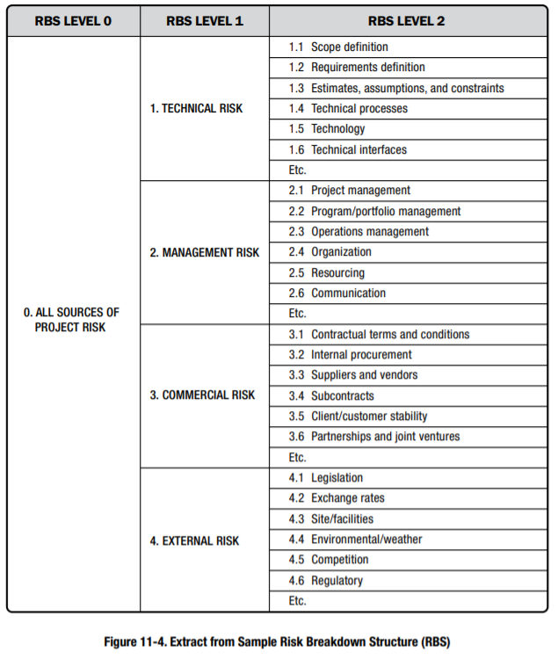
Risk Category
Risk Category:
Provide a means for grouping individual project risks.
A common way to structure risk categories is with a risk breakdown structure (RBS), which is a hierarchical representation of potential sources of risk.
Notes:
External: Regulatory, environmental, or governmental issues; market shifts; problems with project sites, etc.
Internal: Changes to schedule or budget; scope changes; inexperienced team members; issues with people, staffing, materials, and equipment, etc.
Technical: Changes in technology, technical processes, or interfaces, etc.
Commercial: Customer stability, terms and conditions within contracts, vendors, etc.
Unforeseeable: Only a small portion of risks (about 10 percent) are actually unforeseeable.

Slide 15

Meetings
Risk and Opportunity management plan: developed as part of the project kick-off meeting or a specific planning meeting.
Invite selected team members, other stakeholders, experts, anyone responsible for risk management.
Focus on the task, agree on key aspects of the risk approach, identify and overcome sources of bias, and resolve any disagreements.
Conducting risk management activities are defined in these meetings and documented in the risk management plan.
Notes:
Ở Fsoft thường sẽ có risk plan đối với các dự án lớn hoặc domain mới, quan trọng, nhiều expert tham gia ở pre-planning meeting hoặc kick-off meeting.

Slide 16
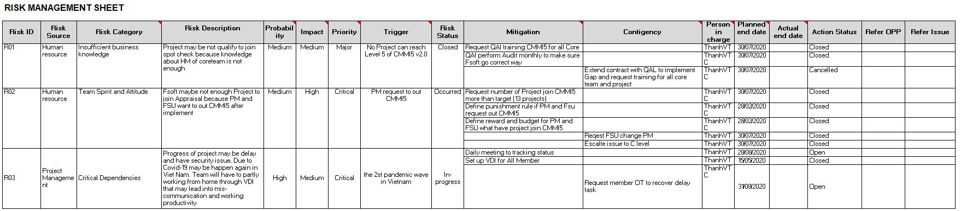
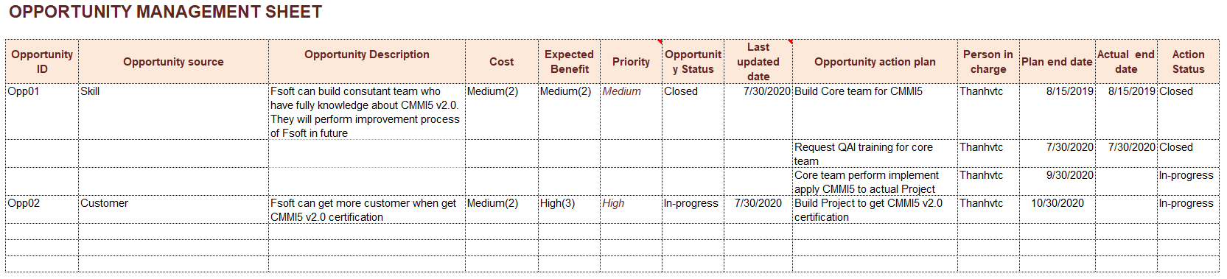
FSOFT Risk and Opportunity Management Plan
Notes:
Refer file: CMMi5 v2.0_Risk and Opportunity Management Sheet v1.0.xlsx

Slide 17
Identify Risks/Opportunities
Identify Risks is the process of identifying individual project risks as well as sources of overall project risk, and documenting their characteristics
The key benefit of this process is the documentation of existing individual project risks and the sources of overall project risk
INPUTS
TOOLS & TECHNIQUES
OUTPUTS
.1 Project management plan
.2 Project documents
.3 Agreements
.4 Procurement documentation
.5 Enterprise environmental factors
.6 Organizational process assets
.1 Expert judgment
.2 Data gathering
.3 Data analysis
.4 Interpersonal and team skills
.5 Prompt lists
.6 Meetings
.1 Risks/Opportunities register
.2 Risks/Opportunities report
.3 Project documents updates

Slide 18
Risk/Opportunity Assessment
Identify Risk:
Study list of commonly occurring risks in Risk Factor Chart and Process Asset to get information about risk and risk management on similar projects.
Evaluating and thinking about previously encountered risks also help identifying other risks that may be pertinent to this project but do not appear on the list.
Go through one-by-one Risk Source & Risk Category and use judgment & experience to evaluate the situation to identify potential risks. Another alternative is to use the project kick-off meetings to elicit views on risks from others.
Identify Opportunity:
Identify and clearly describe opportunities that could positively affect work
Go through one-by-one Opportunity Source (Customer, Business, Technology) use judgment & experience to evaluate the situation to identify potential opportunities. Another alternative is to use the project kick-off meetings to elicit views on opportunities from others.
The identified risks/ opportunities will be log into Template_Risk and Opportunity Management Sheet/ FI 2.0 Risk List
Notes:
Risk Source:
- Customer: Risk nguyên nhân do khách hàng, ví dụ khách hàng không thể trả lời Q&A nhanh trong vòng 2 ngày, khách hàng gửi requirement trễ, gửi device trễ, cung cấp facility ….
- Human resource: Risk phát sinh từ vấn đề con người, Ví dụ : member out Fsoft đột xuất, members không tuân thủ kỷ luật, conflict về member trong dự án, member nghỉ sinh, nghỉ cưới ….
- Project Characteristic: Risk phát sinh do đặc thù của dự án. Ví dụ Dự án phải làm UT bằng script nhưng có 1 số phần UI không viết script được. Hoặc dự án làm làm từ 6h sáng theo timeframe của KH, dự án phải remote để server KH để làm việc …
- Project environment: Risk phát sinh từ vấn đề môi trường, ví dụ môi trường test chưa set up được, hoặc không có môi trường test
- Project management: Risk phát sinh từ vấn đề quản lý. Ví du: PM không daily meeting, ko gửi report, non kinh nghiệm…
- Project Requirement: Risk phát sinh từ vấn đề spec Req, ví dụ án spec viết không rõ ràng, spec thiếu/sai, requirement khó hiểu …
- Technical: Issue về mặt kỹ thuật : Ví dụ: công nghệ mới, task kỹ thuật khó chưa có giải pháp, bug khó ko có solution, hoặc limitation của tool code

Slide 19
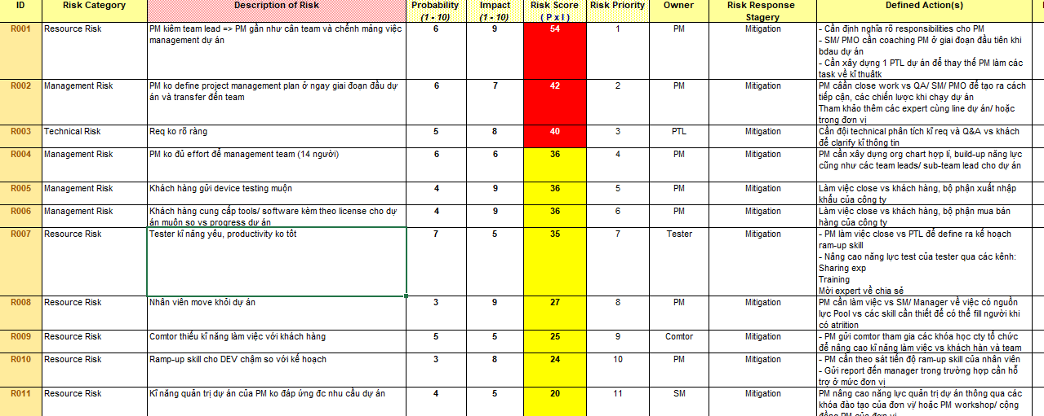
Risks/Opportunities Register
List of identified risks: Identified risks
Potential risk owners: Where a potential risk owner has been identified
List of potential risk responses: Where a potential risk response has been identified

Slide 20


Tools & Techniques: Data gathering
Brainstorming:
Facilitator (Risk Management expert) manages & assist the team
RBS used as main framework to guide discussions
Goal is to creates list of Risks
Involve Project team & other experts
It can be Free-form or can be mass interview
Checklists:
Risk checklists are developed based on historical information and knowledge that has been accumulated from similar projects and from other sources
Interviews:
Interviewing experts, stakeholders, experienced PM

Slide 21
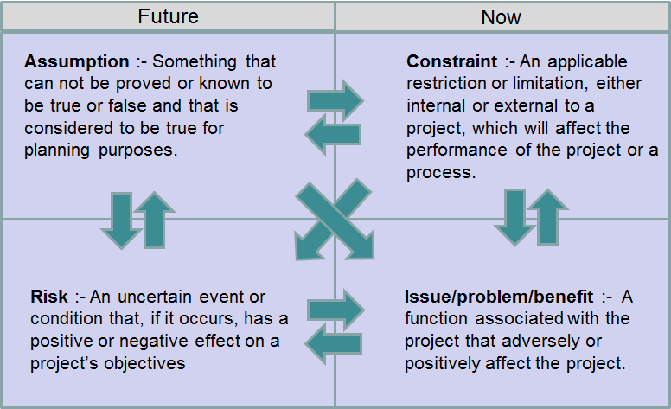
Tools & Techniques: Data analysis
Assumption and Constraint Analysis:
Explores the validity of assumptions and constraints to determine which pose a risk to the project.
Threats may be identified from the inaccuracy, instability, inconsistency, or incompleteness of assumptions.
No. | Description
1 | <Customer> assigned staffing is expected to meet project’s timeline, response Q&A within 1 working day, actual deliverables might need to revised due to delay of responding from <Customer> SME.
2 | Development & Testing environment are confirmed by <Customer> before starting Sprint 1 (2020-Apr-20)
3 | BA is responsible for confirm/feedback Q&A of Offshore team. <Customer> is responsible for confirm and make final decision for difficult Q&As (business, requirement, large impact…) in defined time box.

Slide 22
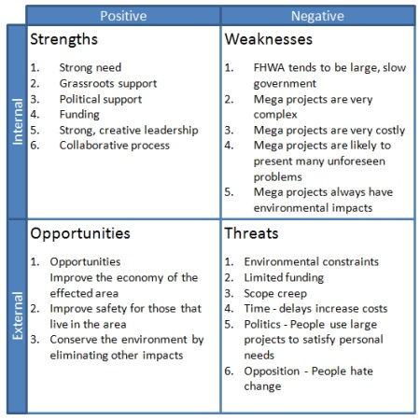
Tools & Techniques: Data analysis
SWOT Analysis: examines the project from each of the strengths, weaknesses, opportunities, and threats (SWOT) perspectives to increase the breadth of identified risks.
Strengths: help you achieve your project's objective.
Weaknesses: limit your project's ability to achieve its objective.
Opportunities: could be taken advantage of to achieve the project's objective.
Threats: could negatively impact the project's ability to achieve its objective.

Slide 23
Perform Qualitative Risk/Opportunity Analysis
Perform Qualitative Risk/Opportunity Analysis is the process of prioritizing risks for further analysis by assessing and combining their probability of occurrence and impact/benefit.
The key benefit of this process is enables PM to reduce the level of uncertainty and to focus on high-priority risks and opportunities.
INPUTS
TOOLS & TECHNIQUES
OUTPUTS
.1 Project management plan
.2 Project documents
.3 Enterprise environmental factors
.4 Organizational process assets
.1 Expert judgment
.2 Data gathering
.3 Data analysis
.4 Interpersonal and team skills
.5 Risk categorization
.6 Data representation
.7 Meetings
.1 Project documents updates

Slide 24
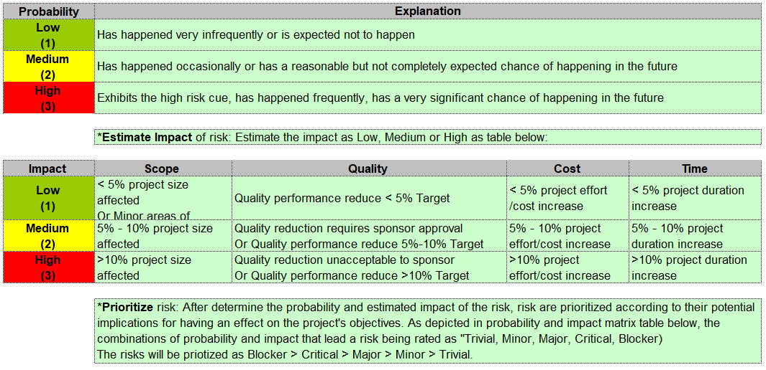
Risk: Probability and Impact Matrix
Notes:
Guideline_Risk and Opportunity Management v1.4.xlsx

Slide 25
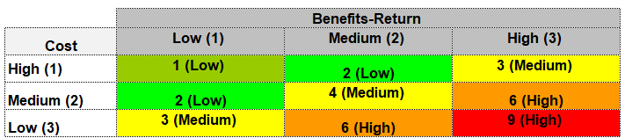
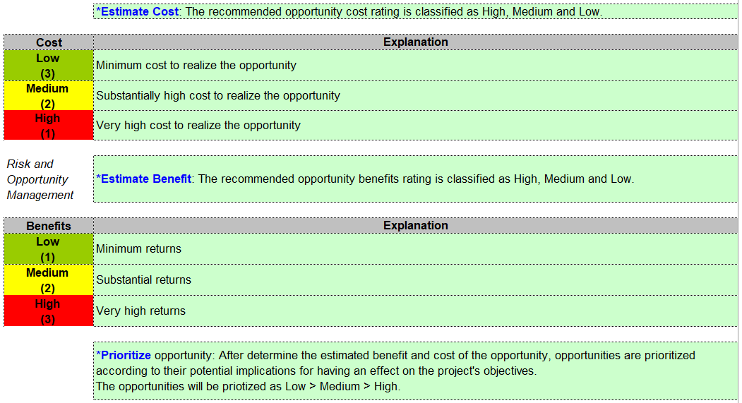
Opportunity: Cost and Benefit Matrix
Notes:
Guideline_Risk and Opportunity Management v1.4.xlsx

Slide 26
Perform Quantitative Risk Analysis
Perform Quantitative Risk Analysis is the process of numerically analyzing the effect of identified risks (that have been prioritized by the Perform Qualitative Risk Analysis process) on overall project objective.
It produces quantitative risk information to support decision making.
INPUTS
TOOLS & TECHNIQUES
OUTPUTS
.1 Project management plan
.2 Project documents
.3 Enterprise environmental factors
.4 Organizational process assets
.1 Expert judgment
.2 Data gathering
.3 Interpersonal and team skills
.4 Representations of uncertainty
.5 Data analysis
.1 Project documents updates

Slide 27
Plan Risk Responses
Plan Risk Response is the process of developing options, strategies and actions to enhance opportunities & to reduce threats to project objectives
It addresses the risks by their priority by updating budget, schedule & project management plan as needed.
INPUTS
TOOLS & TECHNIQUES
OUTPUTS
.1 Project management plan
.2 Project documents
.3 Enterprise environmental factors
.4 Organizational process assets
.1 Expert judgment
.2 Data gathering
.3 Interpersonal and team skills
.4 Strategies for threats
.5 Strategies for opportunities
.6 Contingent response strategies
.7 Strategies for overall project risk
.8 Data analysis
.9 Decision making
.1 Change requests
.2 Project management plan updates
.3 Project documents updates

Slide 28
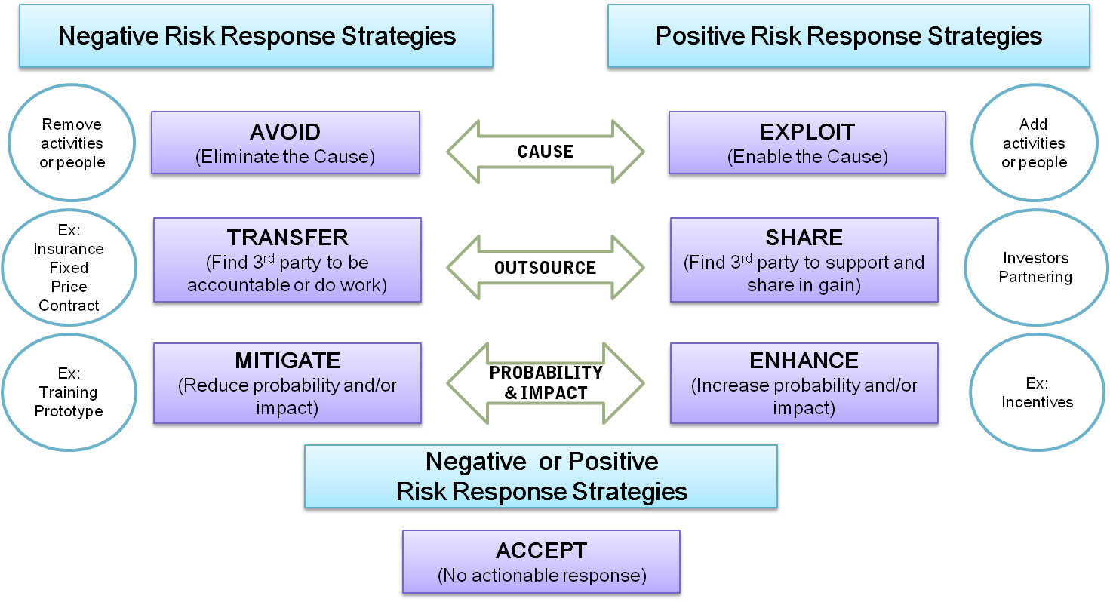
Tools & Techniques: Risk Response Strategies

Slide 29
Strategies for Threats
Avoid
Changing the plan to eliminate a risk by avoiding the cause/source of risk
Transfer
Shift responsibility of risk consequence to another party. Does NOT eliminate risk
Mitigate
Reduce impact or probability of risk to an acceptable threshold
Accept
Protect project from impact of risk
Take early actions to reduce impact/probability
Risk is acknowledged, response is planned
No action taken unless Risk occurs

Slide 30
Strategies for Opportunities
Escalate
Apply with threats outside of scope/exceed PM ‘s authority.
Exploit
Ensure opportunity is realized
Share
Not capable of realizing opportunity on your own
Accept
Willing to take advantage of opportunity if it comes, but not actively pursuing it
Escalated risks are managed at the program level, portfolio…, not on the project level
You do not try, but work hard & ensure opportunity is 100% realized
Work with other parties to share Benefits
Enhance
Increase chances of opportunity occurring

Slide 31
Implement Risk Responses
Implement Risk Response is the process implementing agreed-upon risk response plans.
Ensures that agreed-upon risk responses are executed as planned in order to address overall project risk exposure, minimize individual project threats, and maximize individual project opportunities
INPUTS
TOOLS & TECHNIQUES
OUTPUTS
.1 Project management plan
.2 Project documents
.3 Organizational process assets
.1 Expert judgment
.2 Interpersonal and team skills
.3 Project management information system
.1 Change requests
.2 Project documents updates

Slide 32
Monitor Risks
Monitor Risk is the process of monitoring the implementation of agreed-upon risk response plans, tracking identified risks, identifying and analyzing new risks, and evaluating risk process effectiveness throughout the project
It improves efficiency of risk approach & continuously optimize risk responses
INPUTS
TOOLS & TECHNIQUES
OUTPUTS
.1 Project management plan
.2 Project documents
.3 Work performance data
.4 Work performance reports
.1 Data analysis
.2 Audits
.3 Meetings
.1 Work performance information
.2 Change requests
.3 Project management plan updates
.4 Project documents updates
.5 Organizational process assets updates

Slide 33
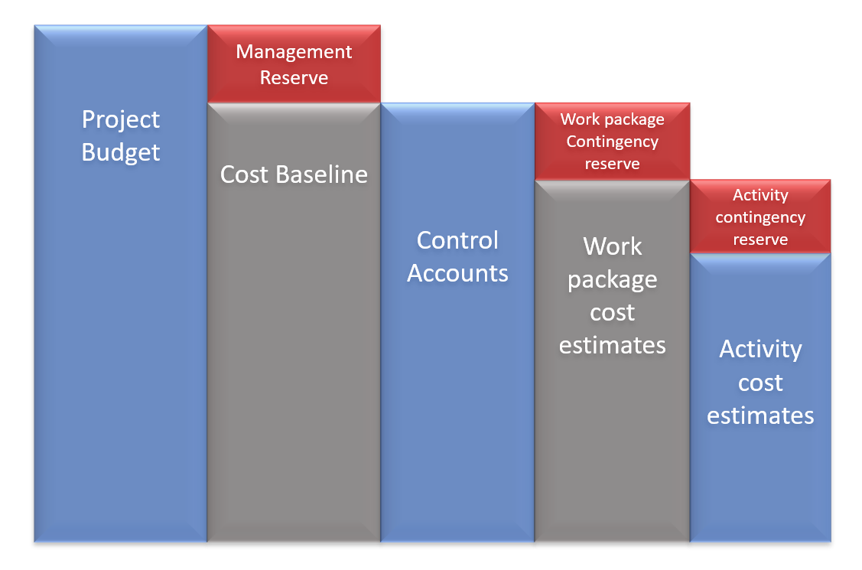
Tools & Techniques: Data analysis
Reserve Analysis:
Compares the amount of the contingency reserves remaining to the amount of risk remaining at any time in the project in order to determine if the remaining reserve is adequate
Notes:
Reserve analysis compares the amount of the contingency reserves remaining to the amount of risk remaining at any time in the project in order to determine if the remaining reserve is adequate

Slide 34
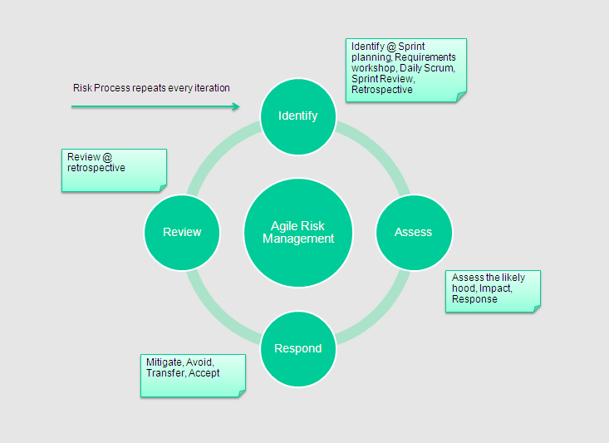
Consideration for Agile model
Frequent reviews of incremental work products and cross-functional project teams to accelerate knowledge sharing and ensure that risk is understood and managed.
Risk is considered when selecting the content of each iteration, and risks will also be identified, analyzed, and managed during each iteration.
Notes:
Bản chất Agile đã là phương pháp để prevent risk (frequent reviews and identified, analyzed, and managed during each iteration)

